Slide 1
THE BOOK
OF
LIFE

Slide 2
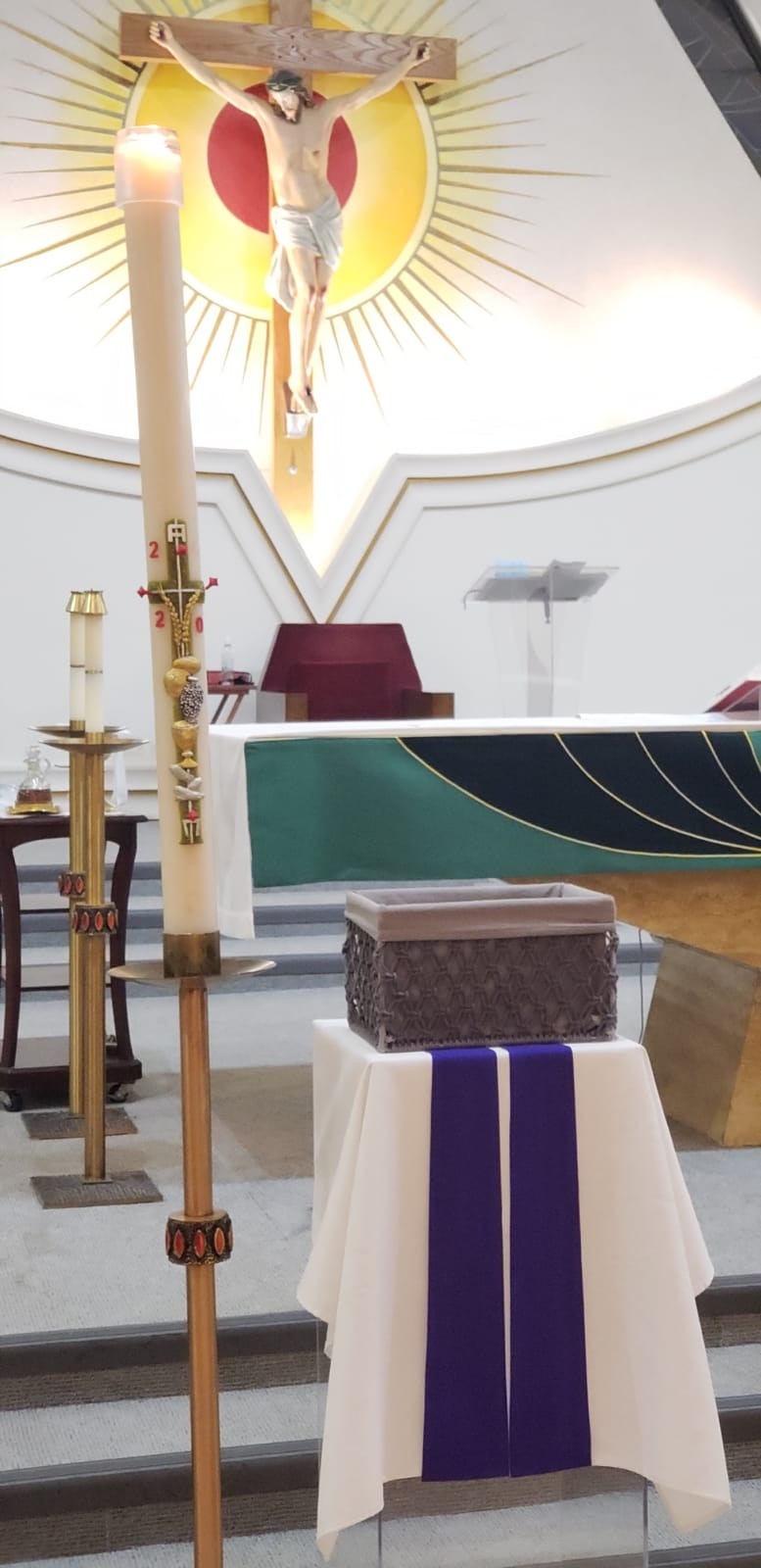
This year, Our Lady Queen of the World Parish re-imagines its annual Book of Life to make this time-honoured tradition safe for our parishioners.
Thus, we invite parishioners to write the names of their Loved Ones who have died, on a slip of paper and place these names of our Dearly Departed in the Basket near the altar and beside the Paschal Candle.
This candle represents the risen Christ . It as a symbol of light (life) dispelling darkness (death).
For our parishioners at home, you may send in the names of your loved ones on the Parish App Prayer Request icon.

Slide 3
We remember our dearly departed Loved Ones during this Month of Remembrance. We pray for all souls whose names are written here in this Book of Life. Masses during the month of November will be celebrated for their intention. “Lord, may the perpetual light shine upon them; may they rest in peace, Amen.”

Slide 4
Eternal rest, grant unto them, O Lord.
+Onuorah Thomas Okpalairechukwu
+Onuorah Cecilia
+Onuorah Nwakaku
+Onuorah Fabian
+Onuorah Clement
+Onuorah Cajethan
+Onuorah Akuejionu
+Onuorah Chukwuemeka
+Onuorah Rosemary
+Oraukwu John Ibemesi
+Oraukwu Joseph
+Oraukwu Cyril
+Owunna Emmanuel
+Owunna Ben
+Ezeribe Simon
+Ezeribe Sunday
+Roger LI POOK THAN
+Georges & Denise LI ON WING
+John & Marie LI POOK THAN
+ Raymond & Moy Yoon LI POOK THAN
+Robert LI POOK THAN
+James LI POOK THAN
+George LI POOK THAN
+Nay Li LI POOK THAN
+Roger LI HOW CHONG
+Dorothy Li
+Great Grandma CHEUNG
+Jax LI ON WING
+Li On Foo
+Paul TANG HUNG TSEUNG

Slide 5
Eternal rest, grant unto them, O Lord.
+Gilbert and Joyce Duncan and their deceased relatives
+Therese Cheung
+Theresa Allison
+John & Wan Kiu Chang
+Alfred Stockle
+Hannelore Manz
+Helene Manz
+Eduard Manz
+Frederick Manz

Slide 6
Eternal rest, grant unto them, O Lord.
+Jack CHENG Chong Lee,
+ CHENG NG Wai Yee
+Annie CHENG
+ James Chang Kang Chiao
+Richard Attai
+Michelina Cornacchia
+Michael Masiak
+ Joe D’Abbruzzo
+ Andrew Robinson

Slide 7
Eternal rest, grant unto them, O Lord
+Francesco & Giusseppina Scarcello
+Paul& Evelyn Farrah
+ Amelia Bozzo
+Ettore Spadafora
+Bill Weisser
+Sergio Dodaro
+Annina
+Giuseppe Scarcello
+Peter Fairweather
+Aunt Lina
+Florette Farrah
+Gino Rinaldi
+Sara Orsini
+Sara Elizabeth Smith
+ Ida Fortuna
+Giuseppe Orsini
+Lorena Servidio
+Emma &Luigi Petracca

Slide 8
Eternal rest, grant unto them, O Lord.
+Abel De Silva
+Adelphina Fernandes
+Florida Uy
+Concordia Uy Miranda
+Joan Roferos
+Jasmine Baguioro
+Zenon Romea
+Joy Camilotes
+Mercedes Minoza Romea
+Teofilo Minoza
+Clemencia Minoza
+Salud Minoza Mesina
+Juana Estomata
+Delfin Uy
+Felipe Uy Sr.
+Alfredo Emnace
+Joan Uy Granada
+Estrella Uy Emnace
Notes:
Delfin Uy

Slide 9
Eternal rest, grant unto them, O Lord.
+Juana Estomata
+Cleto Uy
+Maria Antoinette Minoza Recamadas
+Manuel Gervacio Minoza
+Pilar Sevilla Minoza
+Flora P. Mesina
+Gumersindo Mesina
+Romeo Gervacio Minoza
+Yvette Redman
+Emilia De Leon Gatapia
+Domindor Gatapia Sr., +Vanessa Manila-Dy
+Anna Cornacchia
+ Michelina Cornacchia
+Celestino Cornacchia +Franca Carella
+Jose Imperial & Rita Josefa Obias de Leon

Slide 10
Eternal rest, grant unto them, O Lord.
+John & Wan Kiu Chang
+Domenico Galati
+Teresa Galati
+Galati Children: Rocco, Rosa, Bruno and Caterina
+Giuseppe Furfaro
+Caterina Furfaro
+Gerolamo Furfaro
+Carmela Barbieri
+Fortunato Galati
+Domenic Galati
+Mario Cali
+Vince Leone
+Joseph De Caria
+Zio & Zia Mirenzi
+ Zia & Zio Bono
+Zia & Zio Cali
+Deceased member of the Attisano Family

